Slide 1
IPv4 Address
By: Arnav Kadam

Slide 2
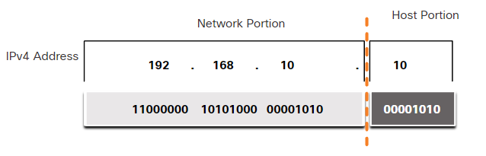
What is an IPv4 address?
32-bit hierarchical address made up of 2 parts
Network Portion
Host Portion
Example → 192.168.10.10
Network → 192.168.10
Host → .10
Bits within network portion must be identical for devices that reside in the same network
Host bits are unique for specific host
Simply, it’s a series of numbers that identifies any device on a network
Ex. camera, laptop, cell phone

Slide 3
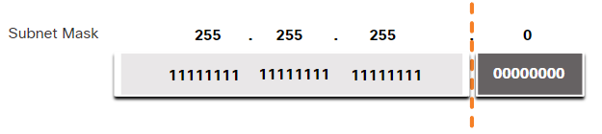
What is a subnet mask?
The subnet mask is used to identify the network/host portion of the IPv4 address
When an IPv4 address is assigned to a device, the subnet mask is used to determine the network address of the device
Network address → represents all the devices on the same network

Slide 4
What is a subnet mask?
The subnet mask is used to identify the network/host portion of the IPv4 address
When an IPv4 address is assigned to a device, the subnet mask is used to determine the network address of the device
Network address → represents all the devices on the same network

Slide 5
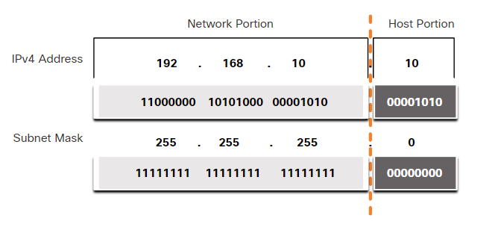
Subnet Mask Example

Slide 6
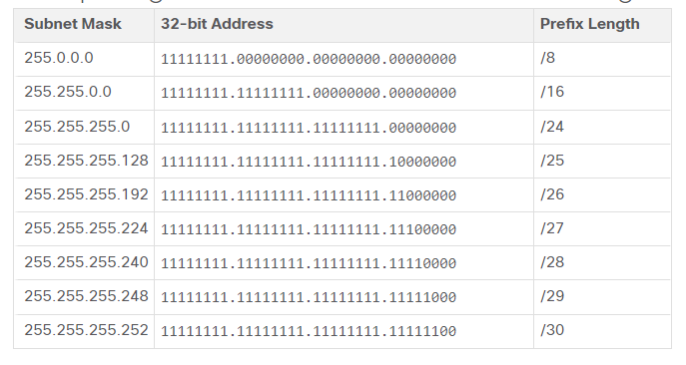
Prefix Length
Constantly using the full subnet mask can be tedious
Prefix Length - number of bits set to 1 in the subnet mask
A network address is also referred to as a prefix or network prefix
Example:
192.168.10.10/24
Mask: 255.255.255.0

Slide 7
Wildcard Mask
IPv4 Address Structure → 192.168.10.0 11000000.10101000.00001010.00000000
Wildcard Mask → 0.0.0.255 00000000.00000000.00000000.11111111
See which bits correspond to the 0’s in the Wildcard Mask.
Important
11000000.10101000.00001010
00000000
Unimportant

Slide 8
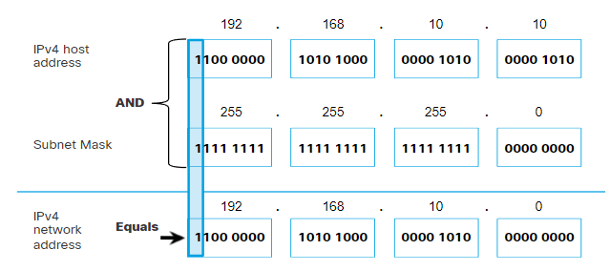
Logical AND
AND is one of the three Boolean operations for digital logic
1 AND 1 = 1
0 AND 1 = 0
1 AND 0 = 0
0 AND 0 = 0

Slide 9
Three Types of IP Addresses
Network Address - represents a specific network
Ex. 192.168.10.0/24
Host address - can be assigned to a specific device, like a laptop
First Host Address: 192.168.10.1
Last Host Address: 192.168.10.254
Broadcast address - used when to required to reach all devices on the IPv4 network
192.168.10.255

Slide 10
Review

